Slide 1
TRIE DATA STRUCTURE

Slide 2
What’s a Trie?
A trie, also called digital tree or prefix tree, is a type of n-ary search tree.
It’s a tree data structure used for locating specific keys from within a set.
The word trie is an excerpt of the word retrieval.
It’s often used to store dynamic set or associative array where the keys are usually strings that can be visualized like a graph. It consists of nodes and edges. Each node consists of at max n children and edges connect each parent node to its children. These n pointers are nothing but pointers for each of the n characters of the alphabet used. A separate edge is maintained for every alphabet.

Slide 3
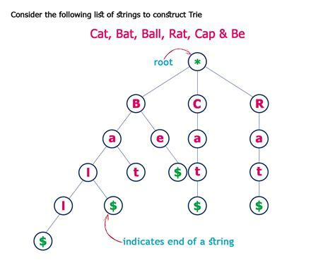
Properties of the Trie for a set of string/s
The root node of the trie always represents the null node.
Each child of nodes is sorted alphabetically.
Each node can have a maximum of 26 children (A to Z).
Each node (except the root) can store one letter of the alphabet.
Example of a trie:

Slide 4
Why Use Trie Data Structure?
When we think about the fastest ways to retrieve values from a data structure, hash tables generally comes to our mind. Though very efficient in nature but still very less talked about as when compared to hash tables, trie's are much more efficient than hash tables and also, they possess several advantages over the same. Mainly:
There won't be any collisions hence making the worst performance better than a hash table that is not implemented properly.
No need for hash functions.
Lookup time for a string in trie is O(k) where k = length of the word.
It can take even less than O(k) time when the word is not there in a trie.

Slide 5
Applications of Trie
Spell Checker
Autocompletion
Sorting (Radix sort)
Search Engines
IP Routing
https://en.wikipedia.org/wiki/Trie

Slide 6
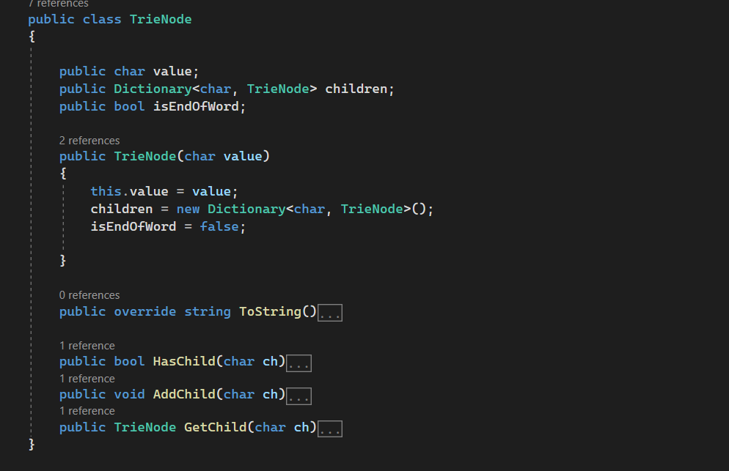
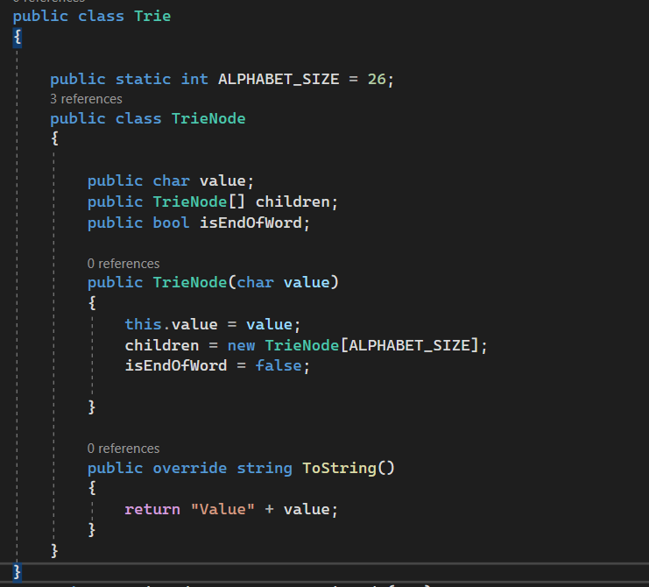
Basics of a Trie
There are three operations in the Trie:
Insertion of a node
Searching a node
Deletion of a node
Basic Structure of a Trie

Slide 7
Insertion of a Node in the Trie
void insert(String word) Inserts the string word into the trie
While inserting a key to the trie, we search if the key is present in the trie or not, because it is possible that we are inserting a key which is the prefix of another key in the trie. Another reason for doing this is that there is a possibility that our new key shares a common prefix with another existing key.
While searching, if the key exists as a prefix, we simply update the value of our current node. If the key does not exist as a prefix, we stop at the node and the character we could not find and start making new nodes with values as null for each of the characters left(except, we assign the given value to the node corresponding to the last character).
Time Complexity: O(L) where L is the length of the new key.
Key-> word

Slide 8
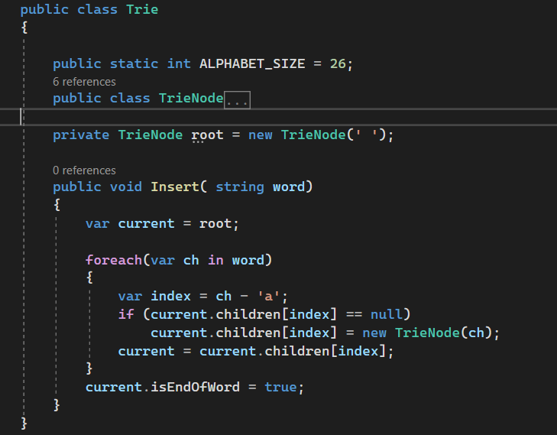
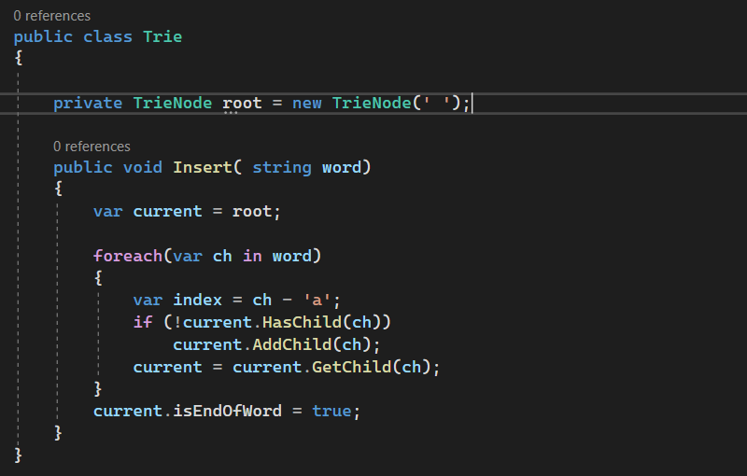
Insertion of a Node in the Trie

Slide 9

Searching of a Node in the Trie
The search operation is used to search a key in the trie.
Searching for a key is similar to an insert operation, however, we only compare the characters and move down.
The search can terminate due to the end of a string or lack of key in the trie.
In the former case, if the isEndofWord field of the last node is true, then the key exists in the trie. In the second case, the search terminates without examining all the characters of the key, since the key is not present in the trie.
Example:
In order to look for a key (say x) in a trie, what we basically do is, extract characters from x one by one and check if the block in the array containing links to the children nodes at index corresponding to our current character points to null or not. If it points to null, the key does not exist, and if it points to another node, we traverse to that node, extract the next character , and repeat the process.
However, there is a catch to this. Even if we find x in our trie, if the value stored in it is null, the key still does not exist. For example, our trie has a key- “Questionable”, and we are searching for “question”. We obviously get a success while looking for “question”, but it is not a key. Thus, this condition is a very important condition while searching and can not be skipped.
Time Complexity: O(L) where L is the length of word.

Slide 10
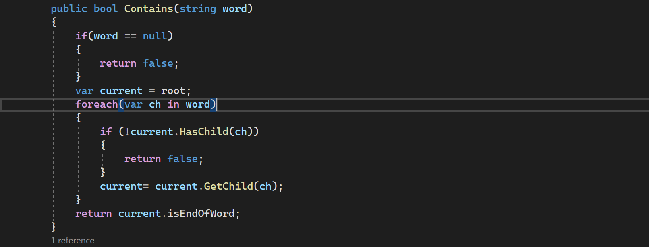
Searching of a Node in the Trie

Slide 11
Deletion of a Node in the Trie
To delete a key, we do not delete the node corresponding to the key as it might have some children which still contain a key. Instead, we simply must search for it and set its value to null.
However, to improve efficiency, if the node corresponding to the key has no children or all its children have null values, we might also delete the entire node.
it is important to understand some points:
If the key is not found in the trie, the delete operation will stop and exit it.
If the key is found in the trie, delete it from the trie.
Time Complexity: O(L) where L is the length of the key to be deleted.

Slide 12
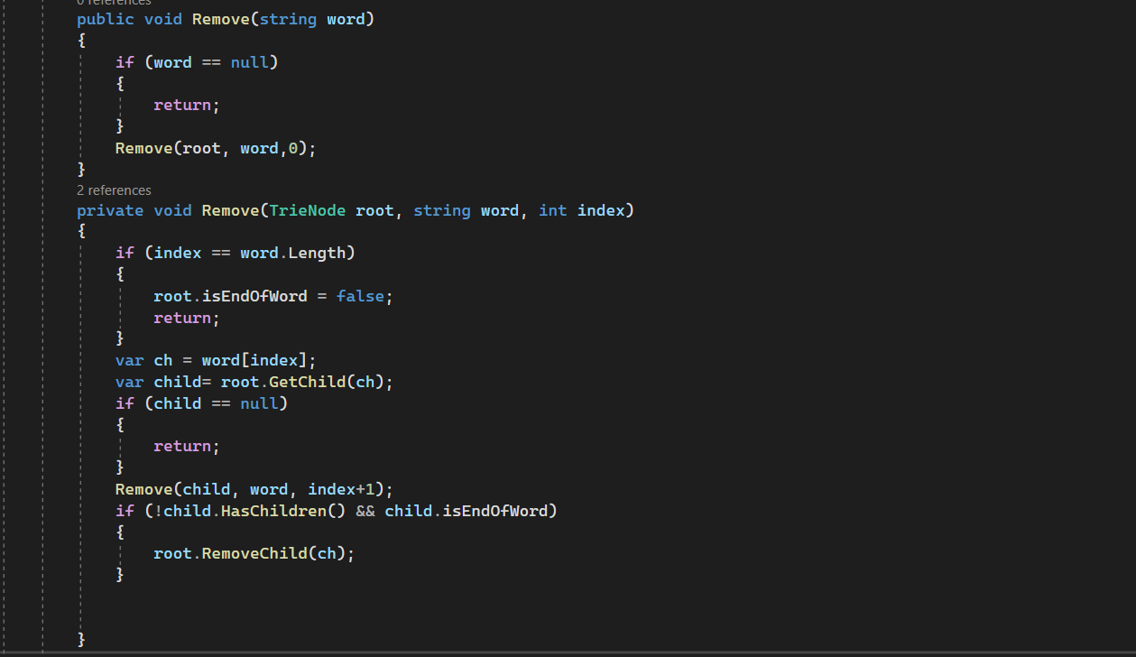
Deletion of a Node in the Trie

Slide 13
Exercises
Design Search Autocomplete System – LeetCode
Design Add and Search Words Data Structure – LeetCode
Longest Duplicate Substring - LeetCode

Slide 14
Exercises on Trees
Easy: Convert Sorted Array to Binary Search Tree
Med: Count Complete Tree notes
Hard: Binary Tree Maximum Path Sum

